Slide 1

WELCOME
COHORT 5
7th Sept – 3rd Dec 2026
Suite 6-6-7, Level 6, Menara MAA

Slide 2
What is Git & GitHub?
Git is a version control system that tracks changes to your code. Think of it as a "save" button for your entire project's history, letting you revisit any version.

Slide 3
What is Git & GitHub?
GitHub is a web-based platform that uses Git. It’s a place to store your code online, collaborate with others, and manage projects. It’s like a social network for coders!
Git is the tool, GitHub is the service.

Slide 4
Your Project's Two Homes
Local Repository: This is the copy of the project on your own computer. It's where you do all your work: writing code, making changes, and testing.
Remote Repository (on GitHub): This is the main copy of the project stored on GitHub's servers. It’s the central hub that everyone on your team shares and updates.

Slide 5
The main Branch: Your Source of Truth
A branch is an independent line of development. The main branch is the default, primary branch for your project.
Think of main as the official, released version of your project. It should always be stable and working.

Slide 6
The main Branch: Your Source of Truth
Avoid working directly on the main branch. Instead, create new branches for features (e.g., feature-login) and merge them into main only when they are complete and tested.

Slide 7
The Local Workflow: add & commit
git add (Staging your changes)
Selects which of your file changes you want to include in your next "save point."
git add is like putting items into a shopping cart. You're getting them ready for checkout, but you haven't finalized the purchase.

Slide 8
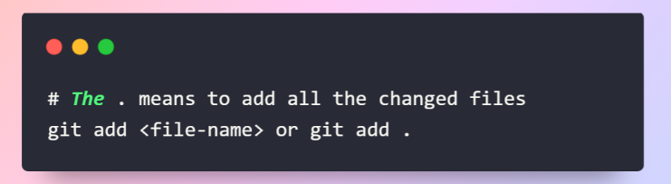
The Local Workflow: add & commit

Slide 9
The Local Workflow: add & commit
git commit (Saving your changes)
Creates a permanent snapshot (a "commit") of your staged changes in the project's history. Each commit has a unique ID and a required descriptive message.
git commit is like checking out your cart. The purchase is final, and you have a receipt (the commit message) detailing what you bought.

Slide 10
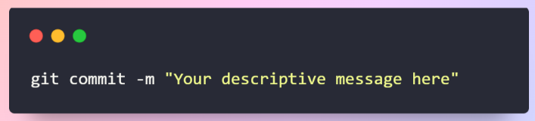
The Local Workflow: add & commit

Slide 11
git push
What it does: push uploads your committed local changes to the remote repository on GitHub.
Analogy: You've written a chapter of a book on your laptop (local). Pushing is like emailing that chapter to your co-author (remote) so they can see your work.
When to use it: After you've committed changes locally and are ready to share them with the team.

Slide 12
git push
What it does: push uploads your committed local changes to the remote repository on GitHub.
Analogy: You've written a chapter of a book on your laptop (local). Pushing is like emailing that chapter to your co-author (remote) so they can see your work.
When to use it: After you've committed changes locally and are ready to share them with the team.

Slide 13
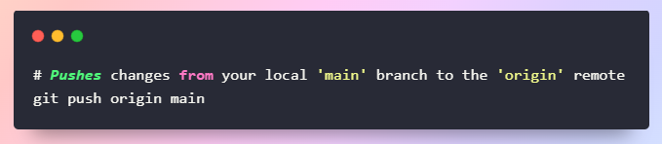
git push

Slide 14
git fetch & git pull
git fetch: This downloads the latest changes from the remote but does not automatically integrate them into your local work. It just lets you see what's new.
git pull: This is a two-in-one command. It fetches the latest changes and automatically tries to merge them into your current branch.

Slide 15
git fetch & git pull
fetch is like getting a notification that a new document is available.
pull is like downloading that document and merging it into your own.

Slide 16
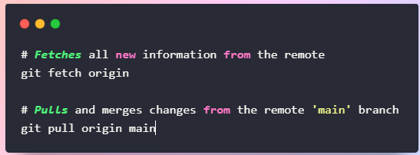
git fetch & git pull

Slide 17
git merge
merge integrates changes from one branch into another. This is the action that happens behind the scenes during a git pull.

Slide 18
git merge
You have two different versions of a document. Merging is the process of combining them into a single, unified document.
When to use it: After a fetch to integrate remote changes, or to combine a feature branch into your main branch.

Slide 19
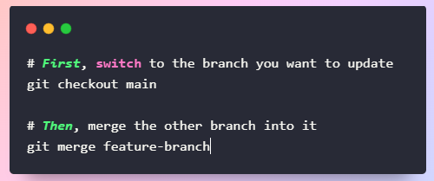
git merge

Slide 20
What is a Merge Conflict?
A merge conflict happens when Git doesn't know how to automatically combine changes from two different sources.
This usually occurs when two people have changed the exact same lines of code in the same file, or when one person edits a file that another person deleted.

Slide 21
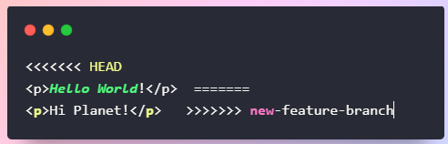
How a Conflict Looks in Code
<<<<<<< HEAD: Marks the start of your local changes.
=======: Separates your changes from the incoming changes.
>>>>>>>: Marks the end of the incoming changes.

Slide 22
How to Solve a Merge Conflict
Open the conflicting file(s). Look for the <<<, ===, and >>> markers.
Decide what to keep.
Edit the file manually. Delete all the conflict marker lines and leave only the code you want to be final.

Slide 23
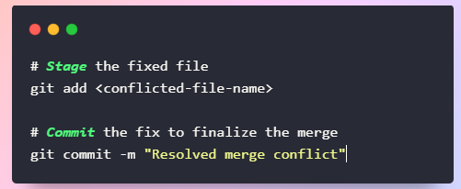
How to Solve a Merge Conflict
Save, add, and commit. This tells Git you've resolved the issue.

Slide 24
Summary & Key Takeaways
main branch: The primary, stable version of your code.
add: Stages your changes, preparing them to be saved.
commit: Creates a permanent snapshot (a "save point") of your staged changes.
push: Sends your local commits up to the remote.
pull: Fetches remote changes and merges them.
Merge Conflicts: Happen when Git can't auto-merge. Edit the file, add, and commit to fix it.

